Slide 1
CIS 427 Computer Networks Mobile Network/Wireless Sensor Network
Fall 2022
Zheng Song (Jason)
CIS Department, UM-Dearborn

Slide 2
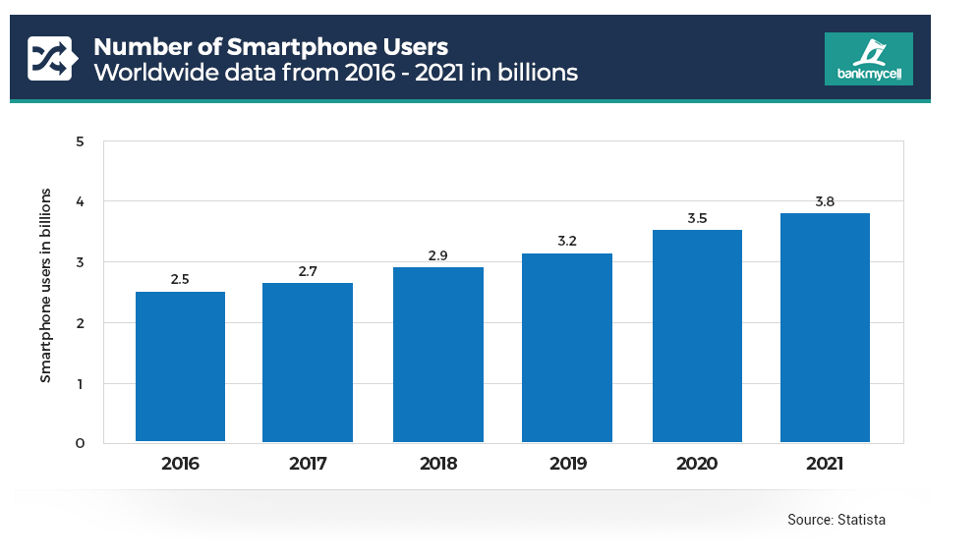
Wireless and Mobile Networks: context

Slide 3
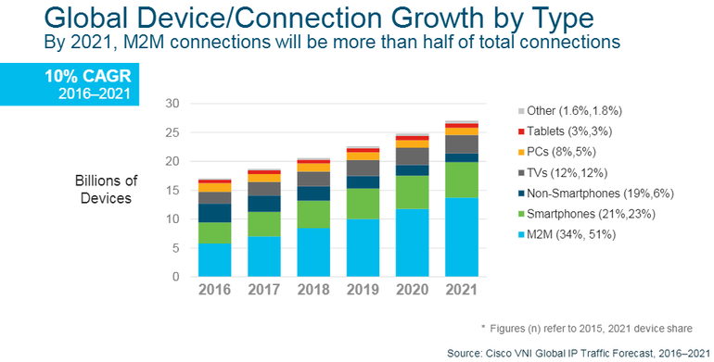
Wireless and Mobile Networks: context
M2M
Smart meters
E-readers
Medical devices
Automobiles
Office devices
Military devices…
Internet of everything (Cisco)
Smarter Planet (IBM)
Notes:
machine-to-machine (M2M) connections that support IoT applications will account for more than half of the world's 27.1 billion devices and connections.

Slide 4
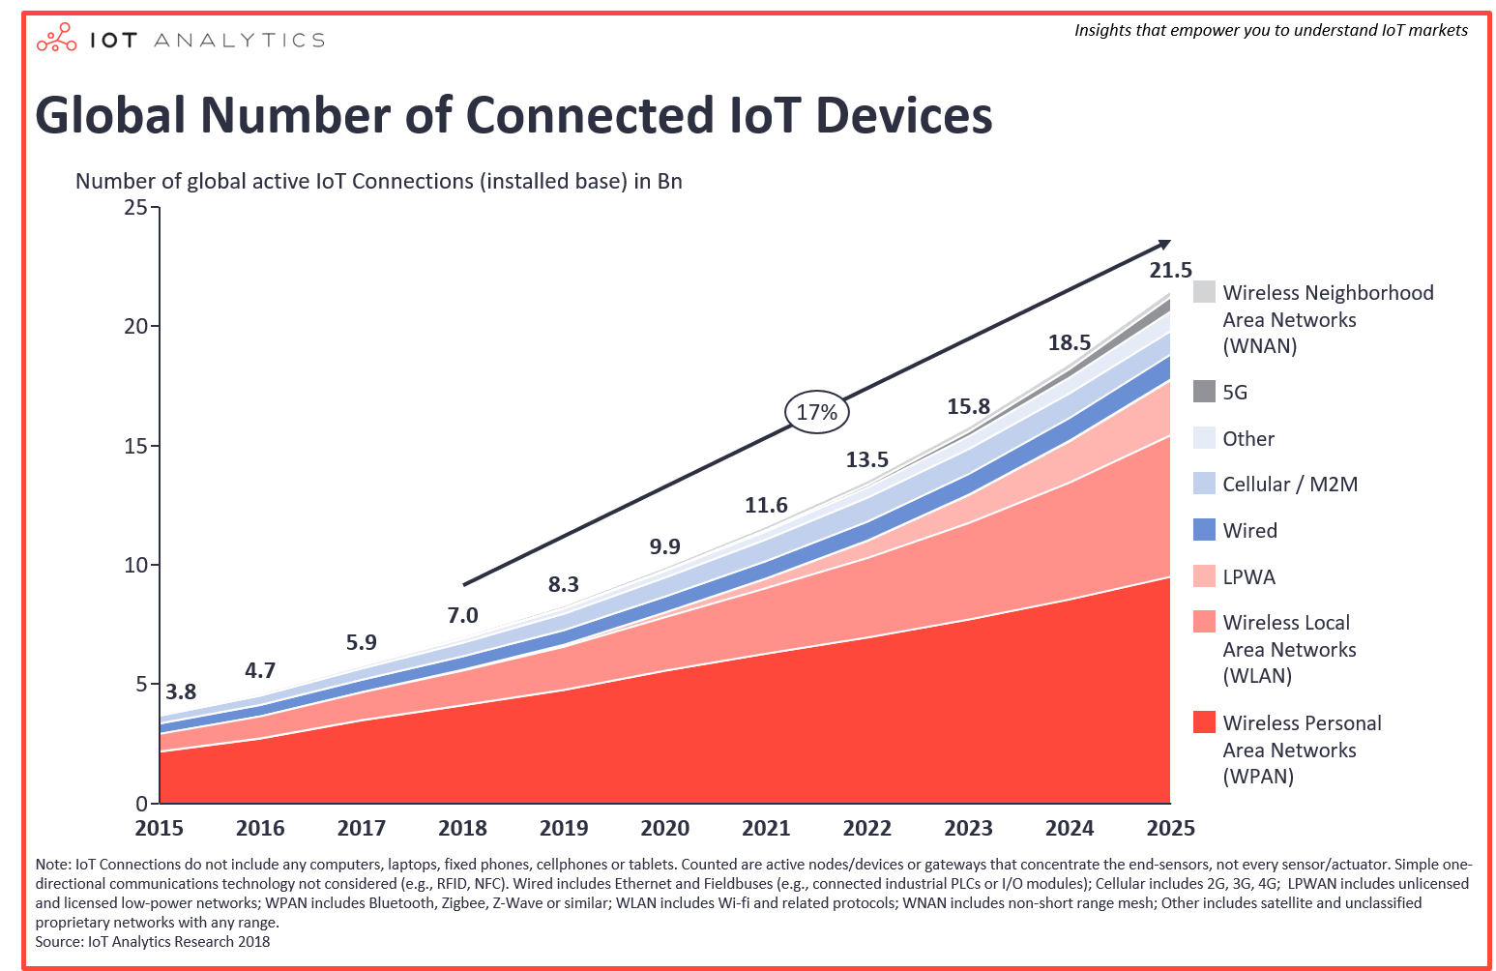
Wireless and Mobile Networks: context
Most devices/access networks go wireless!
WPAN
WLAN
LPWA (LoRa)
Cellular
5G
…
WPAN: Wireless Personal Area Network
WLAN: Wireless Local Area Network
LPWA: low power wide area network
Notes:
LPWA, low power wide area network. (Lora）

Slide 5
Outline
Wireless Communication characteristics
Different Wireless Communication technologies
WiFi: 802.11 wireless LANs
Cellular networks: 4G and 5G
Personal Area Network: BLE, Zigbee, …
LPWA: LoRa
Wireless Sensor Network
Mesh WSN
Delay Tolerant Network
VANET

Slide 6




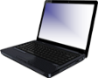
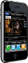





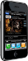


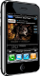




Elements of a wireless network
wired network
infrastructure

Slide 7

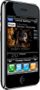


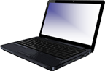
Elements of a wireless network
wireless hosts
laptop, smartphone, IoT
run applications
may be stationary (non-mobile) or mobile
wireless does not always mean mobility!
wired network
infrastructure

Slide 8

Elements of a wireless network
base station
typically connected to wired network
relay - responsible for sending packets between wired network and wireless host(s) in its “area”
e.g., cell towers, 802.11 access points
wired network
infrastructure

Slide 9
Elements of a wireless network
wireless link
typically used to connect mobile(s) to base station, also used as backbone link
multiple access protocol coordinates link access
various transmission rates and distances, frequency bands
wired network
infrastructure

Slide 10
Characteristics of selected wireless links
14 Gbps
802.11ax
10 Gbps
5G
3.5 Gbps
802.11ac
802.11 af,ah
600 Mbps
802.11n
4G LTE
54 Mbps
802.11g
11 Mbps
802.11b
2 Mbps
Bluetooth
Indoor
Outdoor
Midrange
outdoor
Long range
outdoor
10-30m
50-200m
200m-4Km
4Km-15Km
Hidden: Energy Consumption/Deployment Cost
Notes:
Note: these speeds are not shared → each node connected under the above shown protocol can get (theoretically) up to that speed.
Bluetooth is most energy efficient but lowest speed and range.

Slide 11
Elements of a wireless network
infrastructure mode
base station connects mobiles into wired network
handoff: mobile changes base station providing connection into wired network
wired network
infrastructure

Slide 12
Elements of a wireless network
ad hoc mode
no base stations
nodes can only transmit to other nodes within link coverage
nodes organize themselves into a network: route among themselves
Notes:
Adhoc: no intermediary devices (base stations for example, or switches or routers) between hosts.

Slide 13
Wireless network taxonomy
single hop
multiple hops
host connects to base station (WiFi, cellular) which connects to larger Internet
host may have to relay through several wireless nodes to connect to larger
Internet: mesh net
infrastructure
(e.g., APs)
no base station, no connection to larger Internet (Bluetooth, ad hoc nets)
no base station, no connection to larger Internet. May have to relay to reach other a given wireless node MANET, VANET
no
infrastructure

Slide 14
Wireless link characteristics (1)
important differences from wired link ….
decreased signal strength: radio signal attenuates as it propagates through matter (path loss)
interference from other sources: wireless network frequencies (e.g., 2.4 GHz) shared by many devices (e.g., WiFi, cellular, motors): interference
multipath propagation: radio signal reflects off objects ground, arriving at destination at slightly different times
…. make communication across (even a point to point) wireless link much more “difficult”

Slide 15
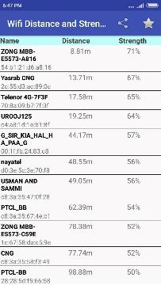
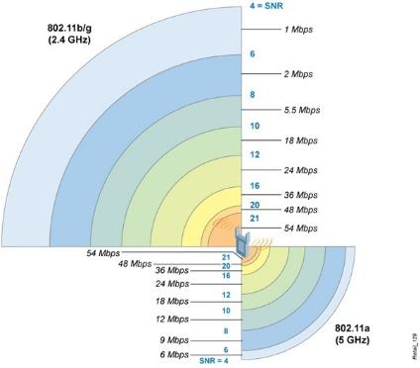
Wireless Link Characteristics
important differences from wired link ….
decreased signal strength: radio signal attenuates as it propagates through matter (path loss)
High frequency 🡪 low wavelength 🡪 High Path Loss
Notes:
So now first we summarize the physical layer characteristics of wireless links. Note that such features are shared by different wireless techniques, like WiFi, Bluetooth, or our cellular communication.
To understand these features, we can start from answering a very practical question. Many times we complain about bad WIFi coverages or connectivity in our home network. So what are the causes of these bad coverages?
The first cause is the path loss, which means the strength of the wireless signal will decrease with distance, as demonstrated by the graph on the left. Our phones use received signal strength indicator (RSSI) to measure the received signal strength of different WiFi access points, as demonstrated in the graph. We can see that when you are within 10 meters range, the strength is around 70%. When you are like 100meters away from the access point, the strength drops to 50%.
However, the bandwidth of the connection doesn’t change this way. In the right graph, we can observe that the strength drops from 21 to 4, but the bandwidth drops from 54Mbps to 1Mpbs. Besides, we can also find that in different WiFi standards, the communication range gets smaller when the frequency increases from 2.4GHz to 5GHz. This is because with higher frequency, the radio wavelength gets lower, and causes higher path loss. We will explain the reason behind this later, but I want you to form the understand that, with higher radio frequency, the coverage range of the signal gets smaller. From 2G, 3G, 4G, to 5G, the frequency of the signal has been raising, so that’s why we need to build more cell towers for 5G networks.

Slide 16
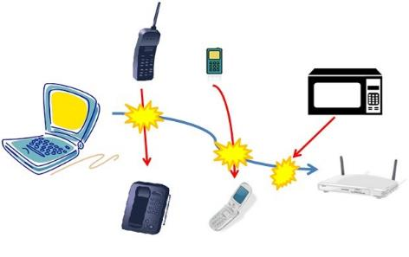
Wireless Link Characteristics
important differences from wired link ….
interference from other sources:
Two devices connected to WiFi
WiFi & BLE (shared the 2.4GHz channel)
Even WiFi & Microwave Oven!!!
Notes:
And the last feature is interference. If you notice, in our home network, when you are using the microwave oven, your WIFi connections become very unstable. That’s because the microwave oven also uses the 2.4GHz frequency. Your WiFi devices are competing for the frequency with each other. Your smart watches may also join the competition as BLE also runs on this frequency. Now we know that microwave is the killer because it has much higher power compared with WiFi and BLE, while it also uses the 2.4GHz frequency.

Slide 17
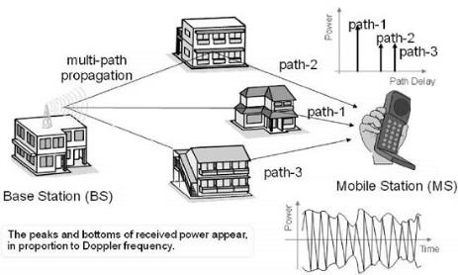
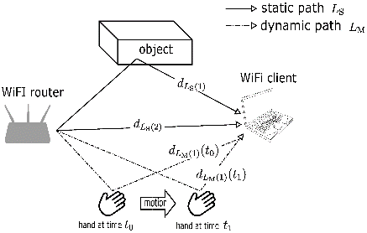
Wireless Link Characteristics
important differences from wired link ….
multipath propagation: radio signal reflects off objects ground, arriving ad destination at slightly different times
Notes:
However, in real world, it is not just the distance that impacts the received signal strength. Another important factor is the multipath propagation or say multipath fading. The radio signal doesn’t travel through the line of sight (LOS) path. It gets reflected by other surfaces and may take longer to arrive. Actually, there has been security attacks using this feature of wireless communication, as demonstrated by the graph on the right. When you type in passwords on your phone in an unsecure environment, the attack can put a compromised WiFi client close to your phone. Due to the multipath propagation, the movement of your fingers changes the received signal on that WiFi client, and the attacker can capture that to learn your password.

Slide 18
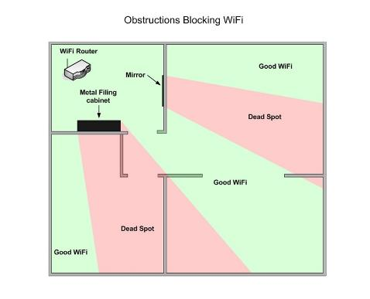
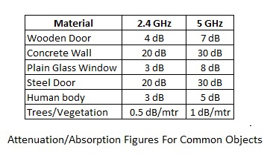
Wireless Link Characteristics
important differences from wired link ….
absorption: radio signal gets weaker passing barriers
Notes:
However, we all know that in our home environment, you can never expect the WiFi signal to be available from a distance of 100m. In fact, we get no signal after maybe 10 meters or at most 20 meters. That is caused by the signal absorption. Basically when the wireless signal passes through some materials, it gets weaker. In the graph we can see that the region behind the mirror and the metal cabinet get poor signals. We can also see that human body can also absorb wireless signals. So it is true that we, the human, can block WiFi signal.
Also we can see that with higher frequencies, the absorption gets worse. That’s another reason why the 5G network needs more cell towers.

Slide 19

Wireless link characteristics (2)
Multiple wireless senders, receivers create additional problems (beyond multiple access):
A
B
C
C
A’s signal
strength
C’s signal
strength
B
A
space
Hidden terminal problem
B, A hear each other
B, C hear each other
A, C can not hear each other means A, C unaware of their interference at B
Signal attenuation:
B, A hear each other
B, C hear each other
A, C can not hear each other interfering at B
Notes:
Wireless nodes do not always know about each other; thus in a multiple access network (network where all nodes use same medium to connect) we cannot use csma/cd (collision detection) but rather csma/ca (collision avoidance).
note: when light is reflected or refracted, frequency stays the same.

Slide 20
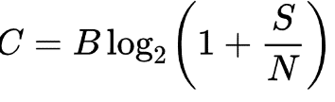
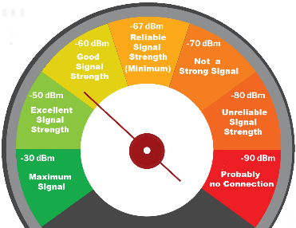
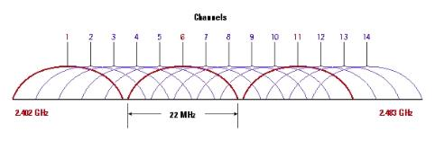
Two Equations:
1. Shannon theorem
C: data transmission bandwidth
B: radio channel bandwidth
S/N: Signal-to-noise ratio
How to improve throughput?
Increase channel bandwidth;
Improve SNR: higher signal strength or lower noise
Notes:
There are two theorems related to all the performance features listed above. First the the Shannon theorem. Basically it means the channel capacity, or say the data transmission bandwidth is related to the radio bandwidth and the signal to noise ratio. The data transmission bandwidth is different from the radio bandwidth. For example, we say that WiFi works on the 2.4GHz frequency level. It doesn’t mean that WiFi works at a frequency point of exactly 2.4GHz. Instead, WiFi takes a range of frequency of 22MHz, and that’s the radio bandwidth. The real range of WiFi is 2.4Hz to 2.49 Ghz, and that range of 90Mhz is divided into three channels for WiFi transmission, with each channel takes 22MHz.
SNR is an important concept if you will work on wireless communication domain. Better SNR means higher data transmission rate. Our phones provide interfaces to retrieve the SNRs of the cell powers we can access and the SNRs of the WIFI signals we receives. Basically we consider SNR above -60 dbm to be useable.
So, based on this equation, we can answer the question of how to improve data transmission bandwidth. The first choice is to increase channel bandwidth. The traditional WIFi standard takes only 22MHz bandwidth because the 2.4GHz frequency is very crowded already. The new WiFI standard improves throughput by changing to 5GHz frequency and occupies wider frequency range or say channel width. Another choice is to improve SNR. One can either improve the signal strength or deduct the noise level.

Slide 21
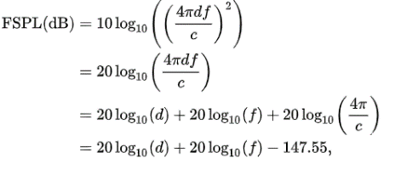
Two Equations:
2. Free Space Path Loss:
Transmitter and receiver in free space
Measured by: transmitted power – received power
To Improve Signal Strength at receiver
High Sending Power
Shorter Distance
Lower Frequency
Bandwidth of low frequency has been fully used!
Notes:
Second is the white space path loss model. White space means that there are no obstructing objects between the transmitter and the receiver. Pass loss can be measured by the difference between transmitted power at the sender and the received power at the receiver. What it says is that path loss is related to distance and radio signal frequency. Higher frequency level of the wireless radio and longer distances cause higher pass loss.
So when we want to improve the bandwidth of wireless communication, what we can do is to, first, raise the sending power. second, shorten the transmission distance, and then use a lower frequency. That’s one of the reason why wireless communication starts from using low frequencies. Like the original radio network, broadcast network, and voice phone network they all use frequencies lower than 1GHz. Now, the low frequency channels have been almost fully occupied. That’s why we move on to 5G. We communicate using higher frequencies so we can have wider radio channel ranges. To compensate the path loss, we deploy more cell towers to reduce the transmission distances.
One may wonder why cannot we increase the sending power. It is because our phones need to be senders as well and they are powered by batteries.

Slide 22
Quiz!
T/F： Higher Frequency leads to higher transmission rate?
Why does 5G take 6GHz & 24.25GHz (millimeter-wave)
T/F： The energy consumption of sending data to a distant receiver is higher.
Notes:
So, before we take a break, let consider these quiz questions:
First, does higher frequency leads to higher transmission rate, or say higher data transmission bandwidth. The answer is no, because as we discussed in the white space path loss model, using lower frequency can reduce the pass loss, and thus improve the SNR.
Then the second question is, why does 5G take the 6GHz and 24GHz radio frequencies? It is because wider frequency ranges can be assigned.
The third is, is the energy consumption of sending data to a distant receiver higher. Hence, it could be very energy consuming if you want to transmit data to a far away cell tower using IoT devices.
Just to recap, in this part, we talked about the common features of wireless communications. We introduce the basic concepts like the base station, the mobile clients, and the core network. We learnt about the Shannon theorem and the free space path loss model, which help us to understand the features of wireless links, like the interference, the multipath propagation, and data transmission bandwidth and how it is impacted by the radio frequency, the radio bandwidth, the distance between the sender and receiver.

Slide 23


Demonstration:
use RSSI to infer distance
human body’s impact on RSSI

Slide 24
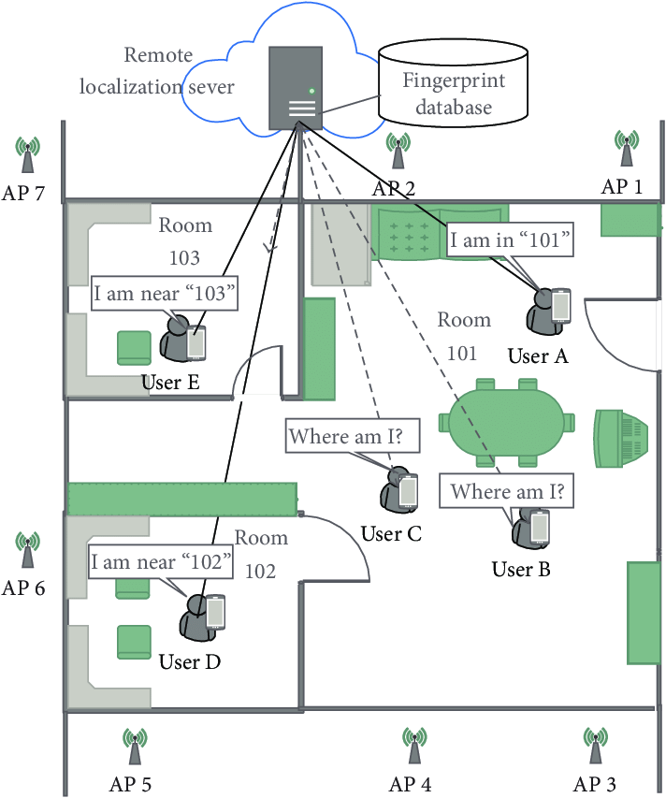
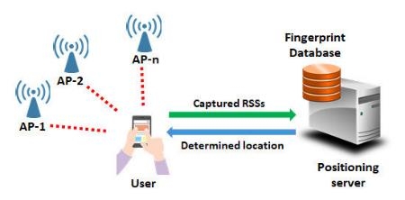
Fingerprint-based Positioning
WiFi/Cellular Signal

Slide 25
Outline
Wireless Communication characteristics
Different Wireless Communication technologies
WiFi: 802.11 wireless LANs
Cellular networks: 4G and 5G
Personal Area Network: BLE, Zigbee, …
LPWA: LoRa
Wireless Sensor Network
Mesh WSN
Delay Tolerant Network
VANET

Slide 26
IEEE 802.11 Wireless LAN
IEEE 802.11 standard | Year | Max data rate | Range | Frequency
802.11b | 1999 | 11 Mbps | 30 m | 2.4 Ghz
802.11g | 2003 | 54 Mbps | 30m | 2.4 Ghz
802.11n (WiFi 4) | 2009 | 600 | 70m | 2.4, 5 Ghz
802.11ac (WiFi 5) | 2013 | 3.47Gpbs | 70m | 5 Ghz
802.11ax (WiFi 6) | 2020 (exp.) | 14 Gbps | 70m | 2.4, 5 Ghz
802.11af | 2014 | 35 – 560 Mbps | 1 Km | unused TV bands (54-790 MHz)
802.11ah | 2017 | 347Mbps | 1 Km | 900 Mhz
all use CSMA/CA for multiple access, and have base-station and ad-hoc network versions

Slide 27

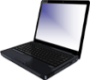


802.11 LAN architecture
Internet
wireless host communicates with base station
base station = access point (AP)
Basic Service Set (BSS) (aka “cell”) in infrastructure mode contains:
wireless hosts
access point (AP): base station
ad hoc mode: hosts only
switch
or router
BSS 1
BSS 2

Slide 28
802.11: Channels, association
spectrum divided into channels at different frequencies
AP admin chooses frequency for AP
interference possible: channel can be same as that chosen by neighboring AP!
arriving host: must associate with an AP
scans channels, listening for beacon frames containing AP’s name (SSID) and MAC address
selects AP to associate with
then may perform authentication
then typically run DHCP to get IP address in AP’s subnet
BSS

Slide 29
802.11: passive/active scanning
BBS 1
BBS 2
BBS 1
BBS 2
1
1
AP 2
AP 1
1
AP 2
2
2
2
AP 1
3
3
4
H1
H1
passive scanning:
beacon frames sent from APs
association Request frame sent: H1 to selected AP
association Response frame sent from selected AP to H1
active scanning:
Probe Request frame broadcast from H1
Probe Response frames sent from APs
Association Request frame sent: H1 to selected AP
Association Response frame sent from selected AP to H1
Notes:
Passive: AP sends out probe frames so that hosts know about the AP.
Active: device sends broadcast message asking for Aps to send out a probe.

Slide 30




IEEE 802.11: multiple access
avoid collisions: 2⁺ nodes transmitting at same time
802.11: CSMA - sense before transmitting
don’t collide with detected ongoing transmission by another node
802.11: no collision detection!
difficult to sense collisions: high transmitting signal, weak received signal due to fading
can’t sense all collisions in any case: hidden terminal, fading
goal: avoid collisions: CSMA/CollisionAvoidance
A
B
C
C
B
A’s signal
strength
C’s signal
strength
A
space

Slide 31
IEEE 802.11 MAC Protocol: CSMA/CA
802.11 sender
1 if sense channel idle for DIFS then
transmit entire frame (no CD)
sender
receiver
DIFS
2 if sense channel busy then
start random backoff time
timer counts down while channel idle
transmit when timer expires
if no ACK, increase random backoff interval, repeat 2
data
SIFS
802.11 receiver
if frame received OK
return ACK after SIFS (ACK needed due to hidden terminal problem)
ACK

Slide 32
Avoiding collisions (more)
idea: sender “reserves” channel use for data frames using small reservation packets
sender first transmits small request-to-send (RTS) packet to BS using CSMA
RTSs may still collide with each other (but they’re short)
BS broadcasts clear-to-send CTS in response to RTS
CTS heard by all nodes
sender transmits data frame
other stations defer transmissions

Slide 33

Collision Avoidance: RTS-CTS exchange
A
B
AP
RTS(A)
RTS(B)
reservation collision
RTS(A)
CTS(A)
CTS(A)
time
DATA (A)
defer
ACK(A)
ACK(A)
Notes:
Pink bar is a message sent to all nodes by the AP.
AP detects the collisions and manages reservations
Nodes will do random backoff timer if they do not receive reservation confirmation from router in a certain amount of time.
Once reservation is granted the router broadcasts to all other nodes so that they know to stop trying to reserve the channel
Then A can transmit
Then router sends broadcast ACK to all nodes informing them that the channel is no longer reserved by A and they can attempt to reserve it again.

Slide 34
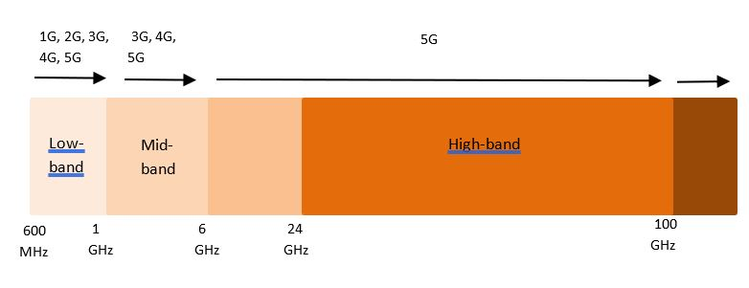
Difference between 2G/3G/4G?
Short Answer:
2G: voice(telephone) network
3G: both phone network and Internet (data network)
4G: all internet
Speed/Bandwidth
Notes:
So I bet many of you shares the same wonder as I do, we see the cellular network evolves from 2G to 3G and 4G, what do these Gs mean, right?
The short answer to the question is that, 2G uses the voice network to transmit data, like messages. 3G uses both phone network and Internet or say the data network. 4G only uses the internet.
Another significant difference between them is that, the frequencies of these standards keep increasing. Along with such trends, the coverage of the cell tower keep decreasing, which means we will see more cell towers for 5G network.

Slide 35
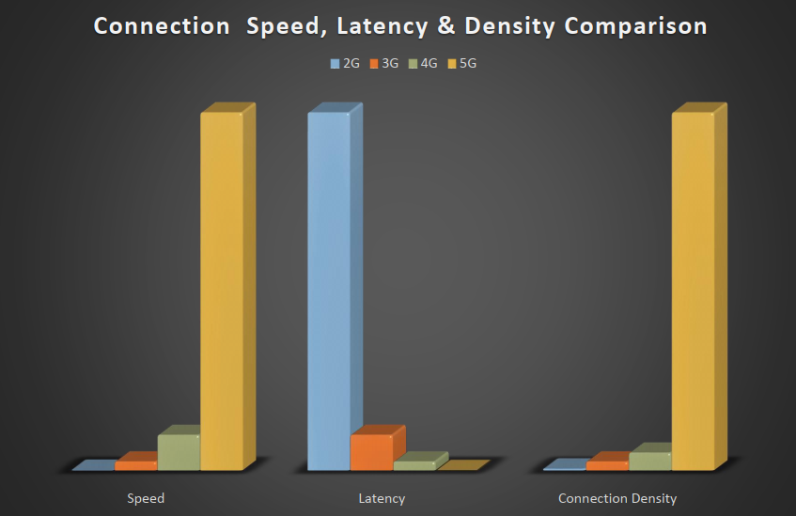
4G/5G Network
4G Focus Area
5G Focus Area
Speed/Throughput
Data
Connection Density
Latency/Delay

Slide 36
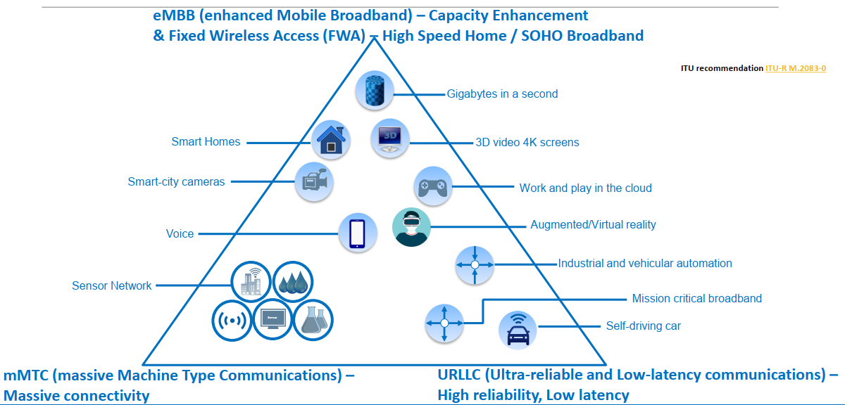
Why we need 5G?

Slide 37
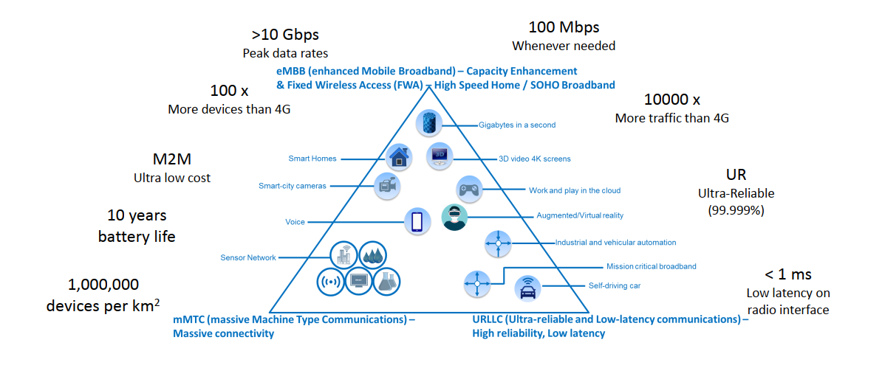
Why we need 5G?

Slide 38
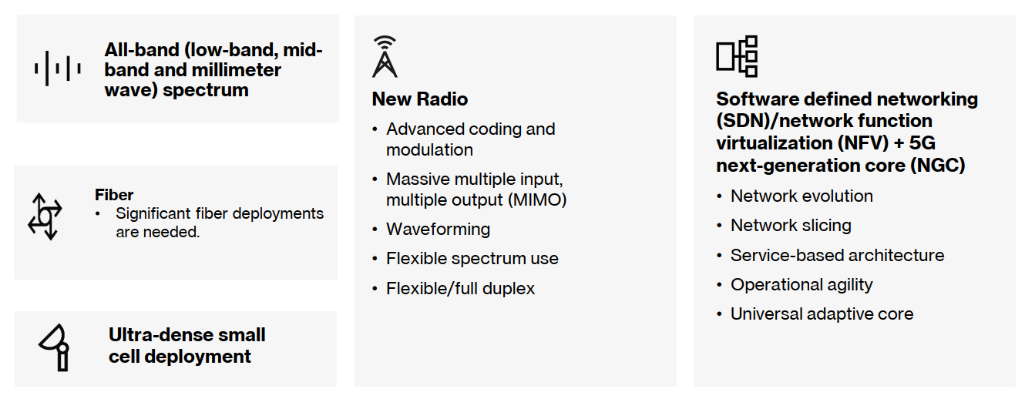
5G building blocks
Dr. Andrea Goldsmith, What’s Beyond 5G https://www.youtube.com/watch?v=ReGofBrbuLU
https://www.youtube.com/watch?v=GEx_d0SjvS0
Notes:
So the new release iPhone now supports 5G network. You may heard of 5G a lot, but only knows that it provide faster network. Here is a very informative video about what is 5G. It is about 6 minutes long. Please pause this video and watch that one first.
So all the 5 techniques mentioned in the video forms our 5G network. Another aspect of 5G is the deployment of edge computing servers, which provides lower latencies by putting the computational power closer to the edge of the network, close to our mobile clients and IoT devices.
If you are interested, you can continue with this video by Dr. Andrea Goldsmith, the head of the wireless system lab at standford. She talks about the features research directions of 5G network.

Slide 39

Does 5G meet its expectation?
High deployment cost
Long end-to-end latency (not caused by the access network)
Solution:
Edge Computing
Starlink: https://www.youtube.com/watch?v=m05abdGSOxY
after you finish the video:
Typical latency and throughput of starlink
How to calculate the latency introduced by ground relay
changes to network structure
research/engineering challenges
Notes:
So the new release iPhone now supports 5G network. You may heard of 5G a lot, but only knows that it provide faster network. Here is a very informative video about what is 5G. It is about 6 minutes long. Please pause this video and watch that one first.
So all the 5 techniques mentioned in the video forms our 5G network. Another aspect of 5G is the deployment of edge computing servers, which provides lower latencies by putting the computational power closer to the edge of the network, close to our mobile clients and IoT devices.
If you are interested, you can continue with this video by Dr. Andrea Goldsmith, the head of the wireless system lab at standford. She talks about the features research directions of 5G network.

Slide 40
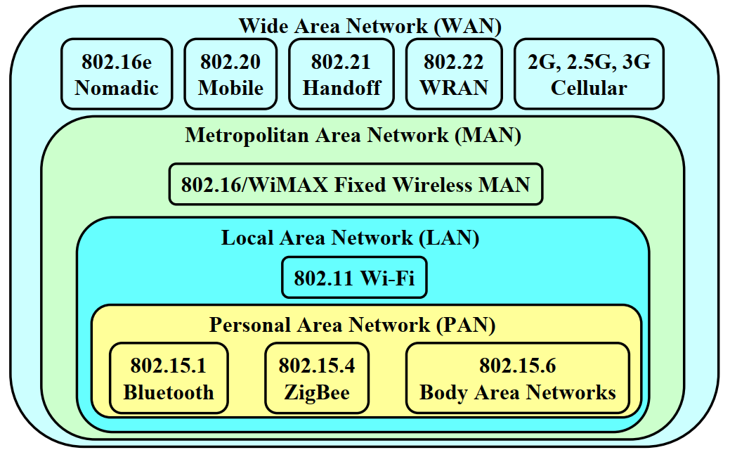
Personal Area Network: PAN
Personal Area Network: 10m or less
replacement for cables (mouse, keyboard, headphones)
ad hoc: no infrastructure
Low communication range
Low data rate
Low energy consumption

Slide 41
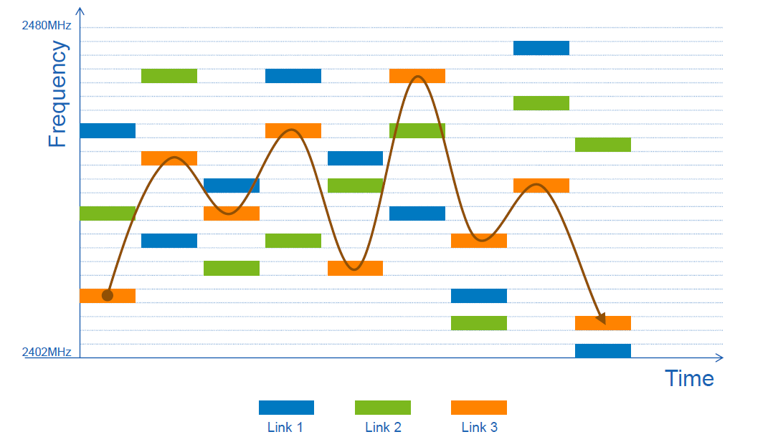
Personal area networks: Bluetooth
2.4-2.5 GHz ISM radio band, up to 3 Mbps
master / clients devices (piconet):
master polls clients, grants requests for client transmissions
parked mode: clients can “go to sleep” (park) and later wakeup (to preserve battery)
Frequency hopping:
C
P
P
radius of
coverage
M
C
C
P
P
M
master device
client device
parked device (inactive)
C
P
Notes:
This is still AdHoc; the master device is still a end-user host device.
Multi-access: polling…
Up to 7 active clients, 255 parket clients.
Frequency changing over time for security purposes.

Slide 42
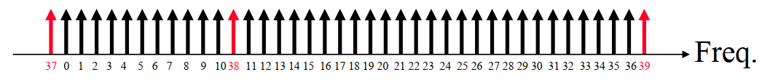
Bluetooth Low Energy (BT4.x, 5.x)
40 Channels with 2MHz Spacing for Frequency hopping
3 channels reserved for advertising and 37 channels for data
Advertising channels specially selected to avoid WiFi interference
Two device types: peripherals and central
Non-connectable advertising: Broadcast data
Discoverable advertising: send data without connection (per request)
Implementation: generic attribute profile (each attribute has a 16bit UUID)
Notes:
Universally unique ID

Slide 43
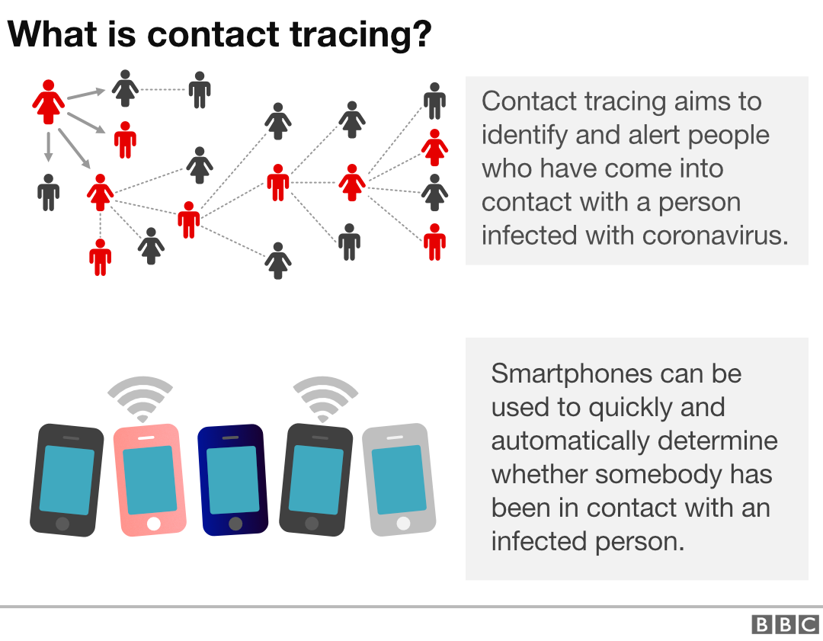
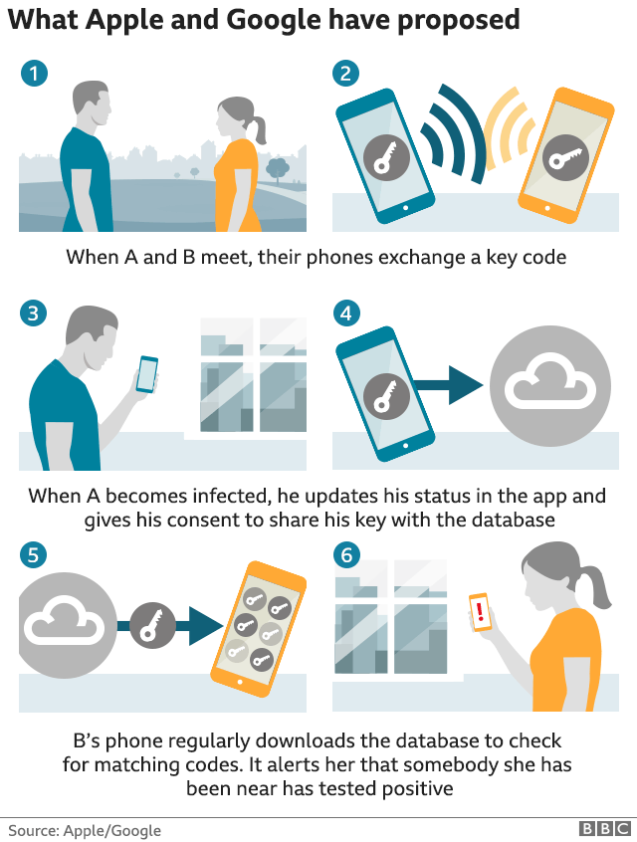
BLE Application: COVID Contact Tracing
COVID Tracking UUID: 0xFD6F
https://covid19-static.cdn-apple.com/applications/covid19/current/static/contact-tracing/pdf/ContactTracing-BluetoothSpecification.pdf
Notes:
UUID has an application key, and identification value so that other devices know that there is a device running the Tracking application, and also identify the device by the id value.

Slide 44
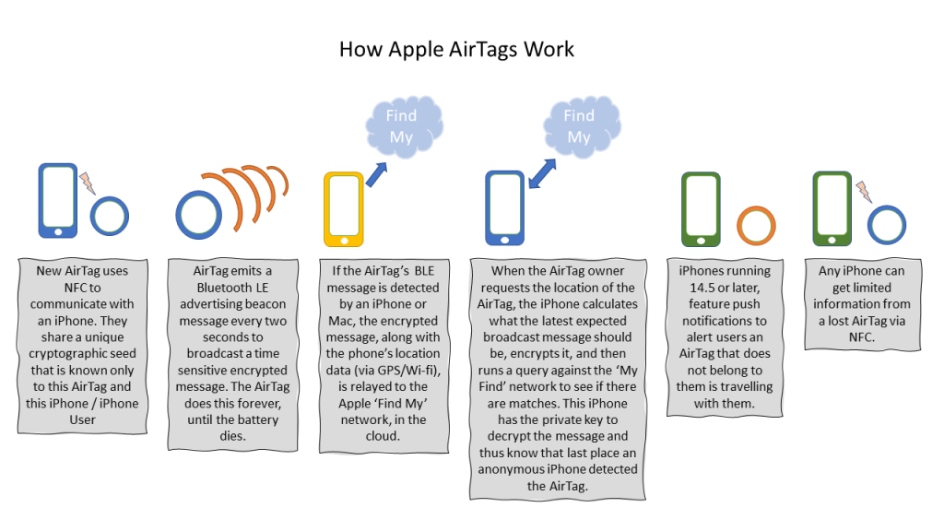
Apple Airtag

Slide 45
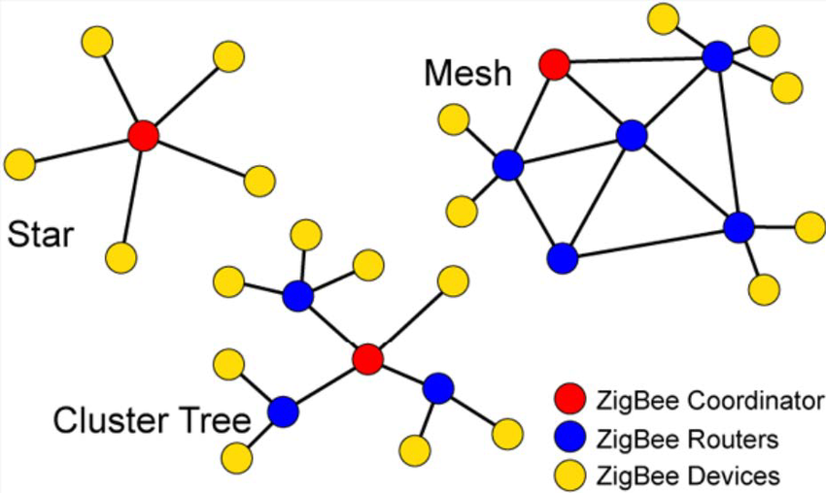
Personal area networks: ZigBee
2.4Ghz, mesh network
Varies network topology:
Used in industrial networks (WSNs)
Optimized for self-organized environments:
Interference detection and channel switching
Dynamic Rerouting
Asymmetric link
Ad-hoc On-demand Distance Vector Routing
What is distance vector?
Why distance vector (not link state?)
Notes:
Link Management: Each node maintains quality of links to neighbors. Link quality is used as link cost in routing
Asymmetric Link: Each node has different transmit power and sensitivity. Paths may be asymmetric.
Ad-hoc On-demand Distance Vector Routing ❑ On-demand ⇒ Reactive ⇒ Construct a route when needed ❑ Routing Table: Path is not stored. Only next hop. ⮚ Entry = <destination, next node, "sequence #" (timestamp)> ❑ Route Discovery: Flood a route request (RREQ) to all neighbors. Neighbors broadcast to their neighbors ❑ Request ID is the RREQ serial number. Used to discard duplicates. Source sequence # is a clock counter incremented when RREQ is sent. Destination sequence # is the most recent sequence from the destination that the source has seen. Zero if unknown

Slide 46

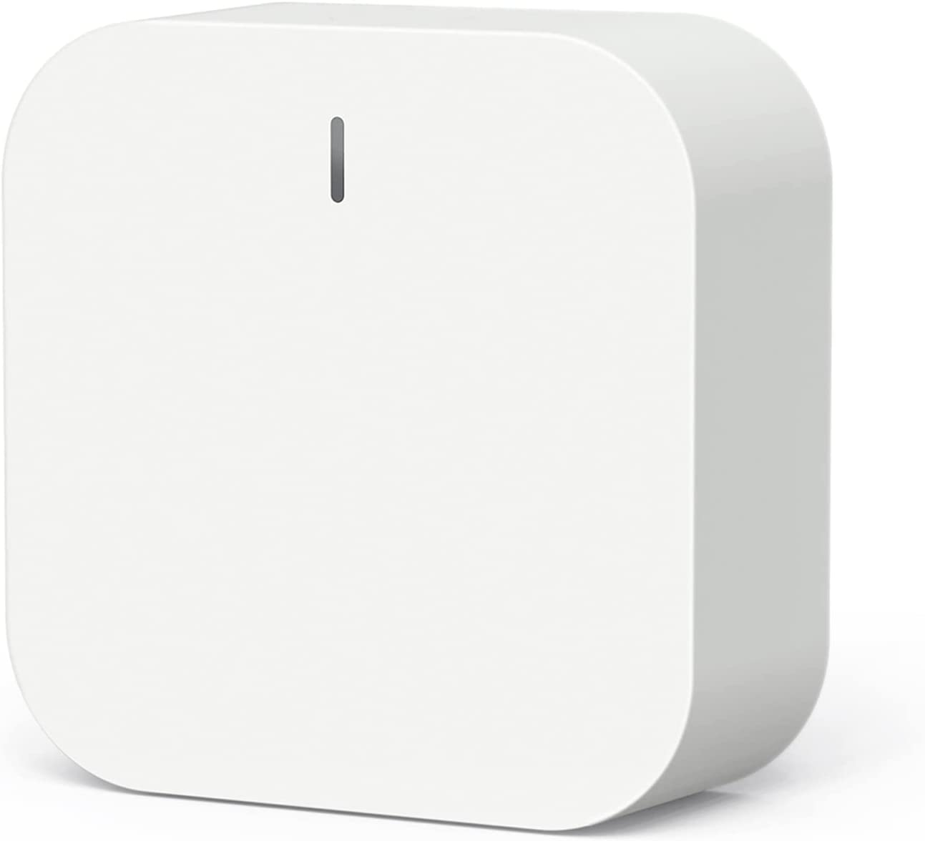
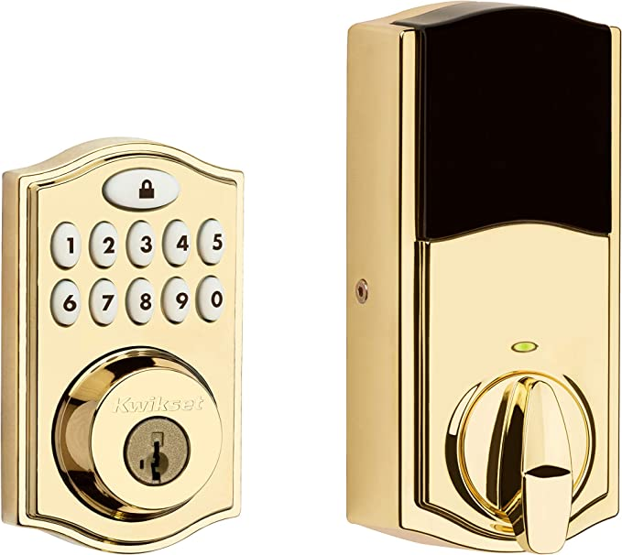
Zigbee at home
Problem: need a (dedicated) hub

Slide 47
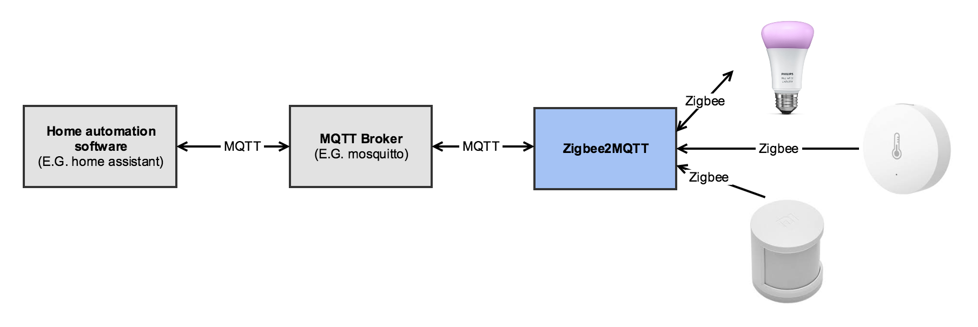
Zigbee in smart home applications
https://github.com/Koenkk/zigbee2mqtt

Slide 48

LPWAN: Low Power Wide Area Network
Long Range
Low Power
Low Data Rate

Slide 49
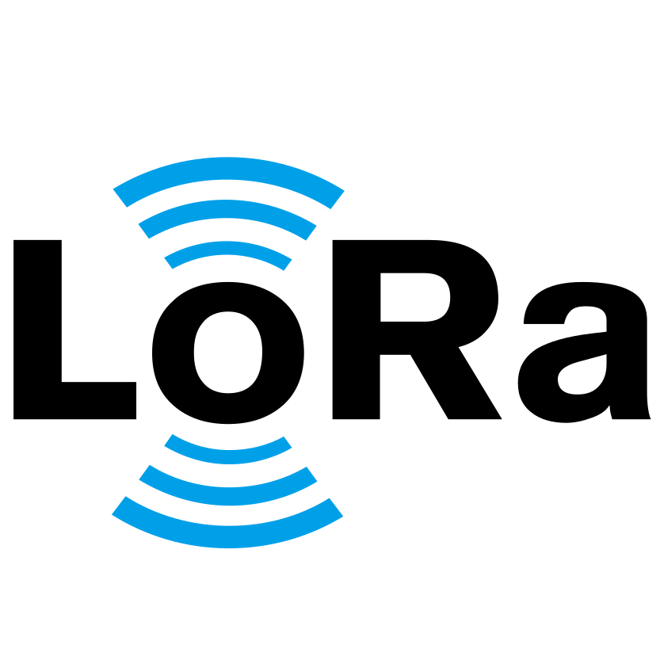
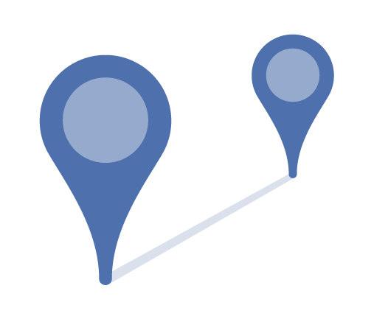

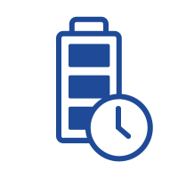
LoRa, the most popular LPWAN Tech
LoRa: Long Range…
9 miles
50 kbps
10 years

Slide 50
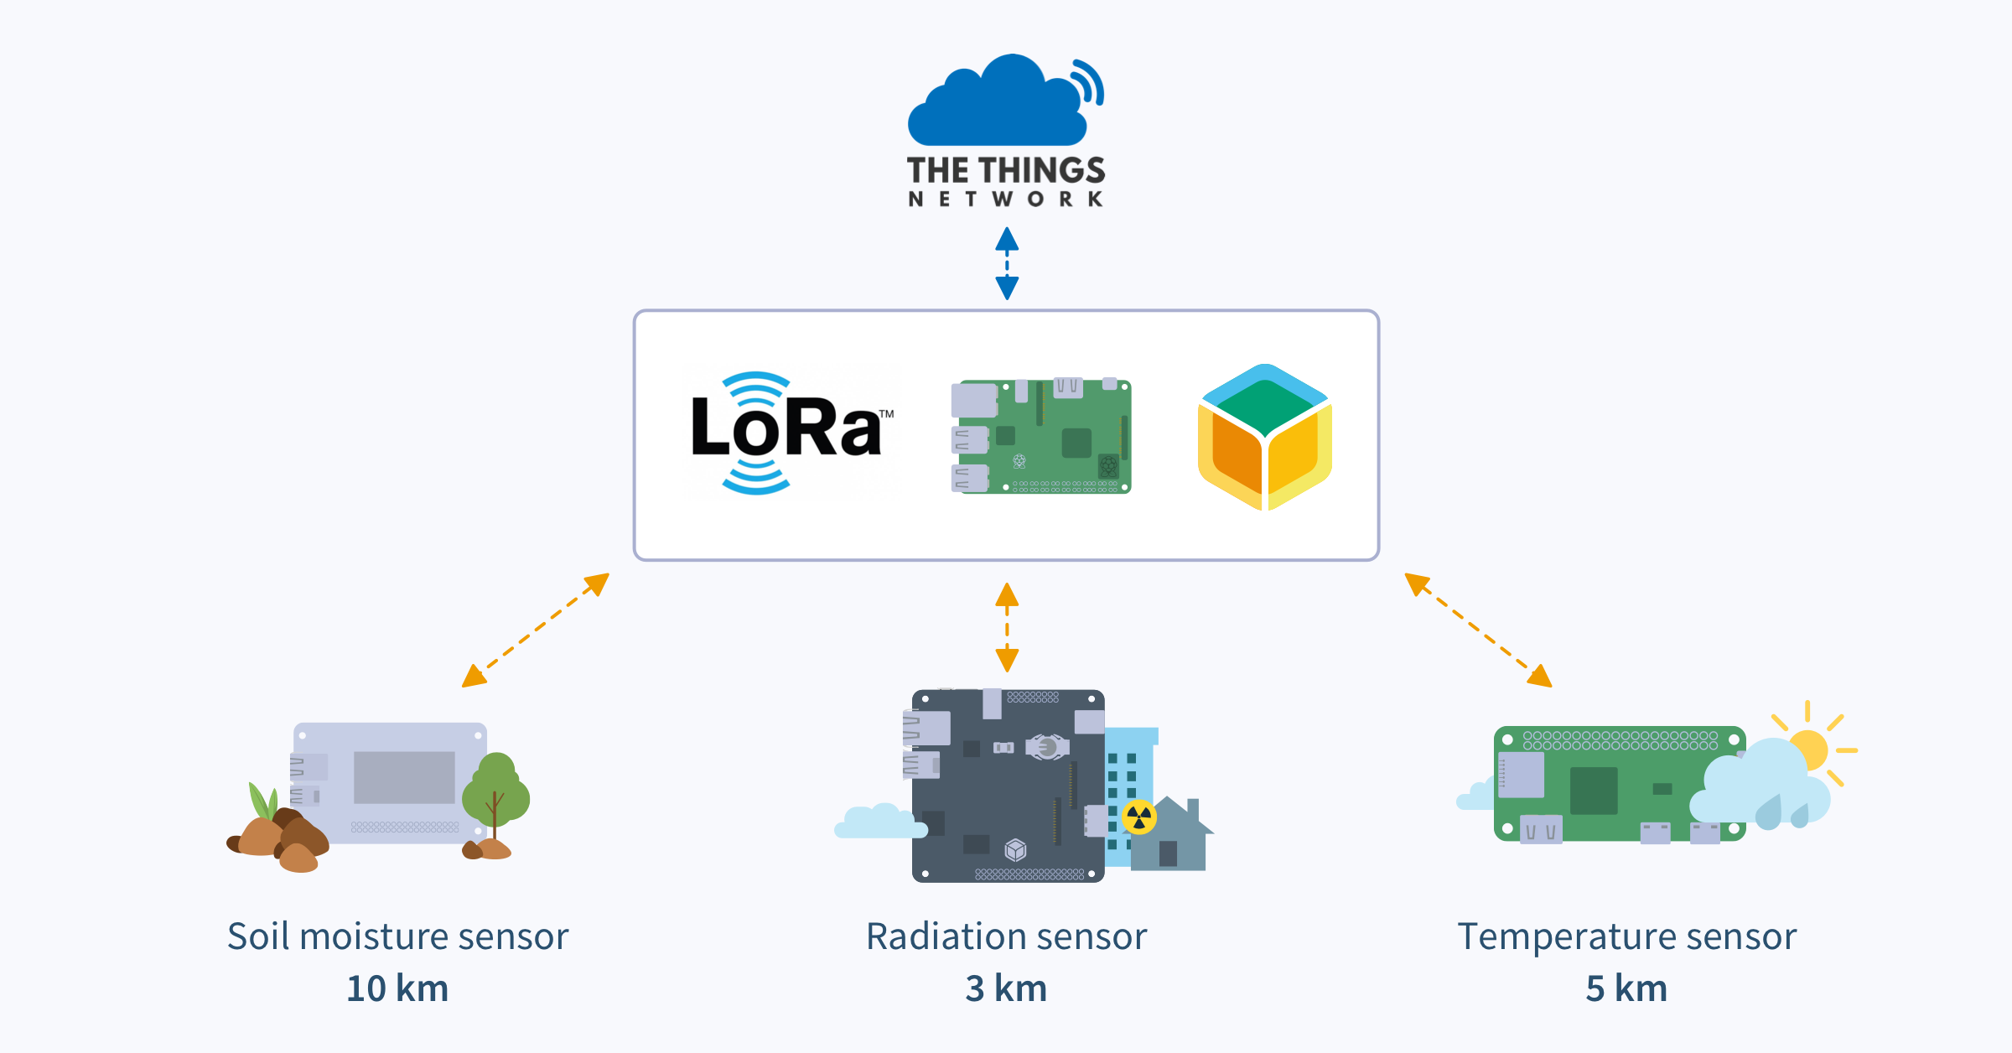
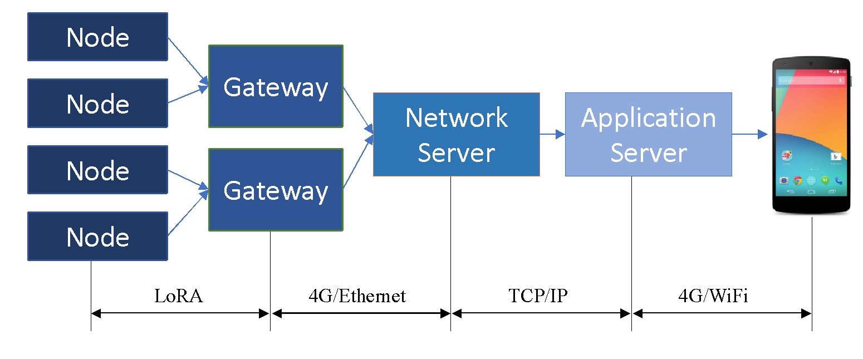
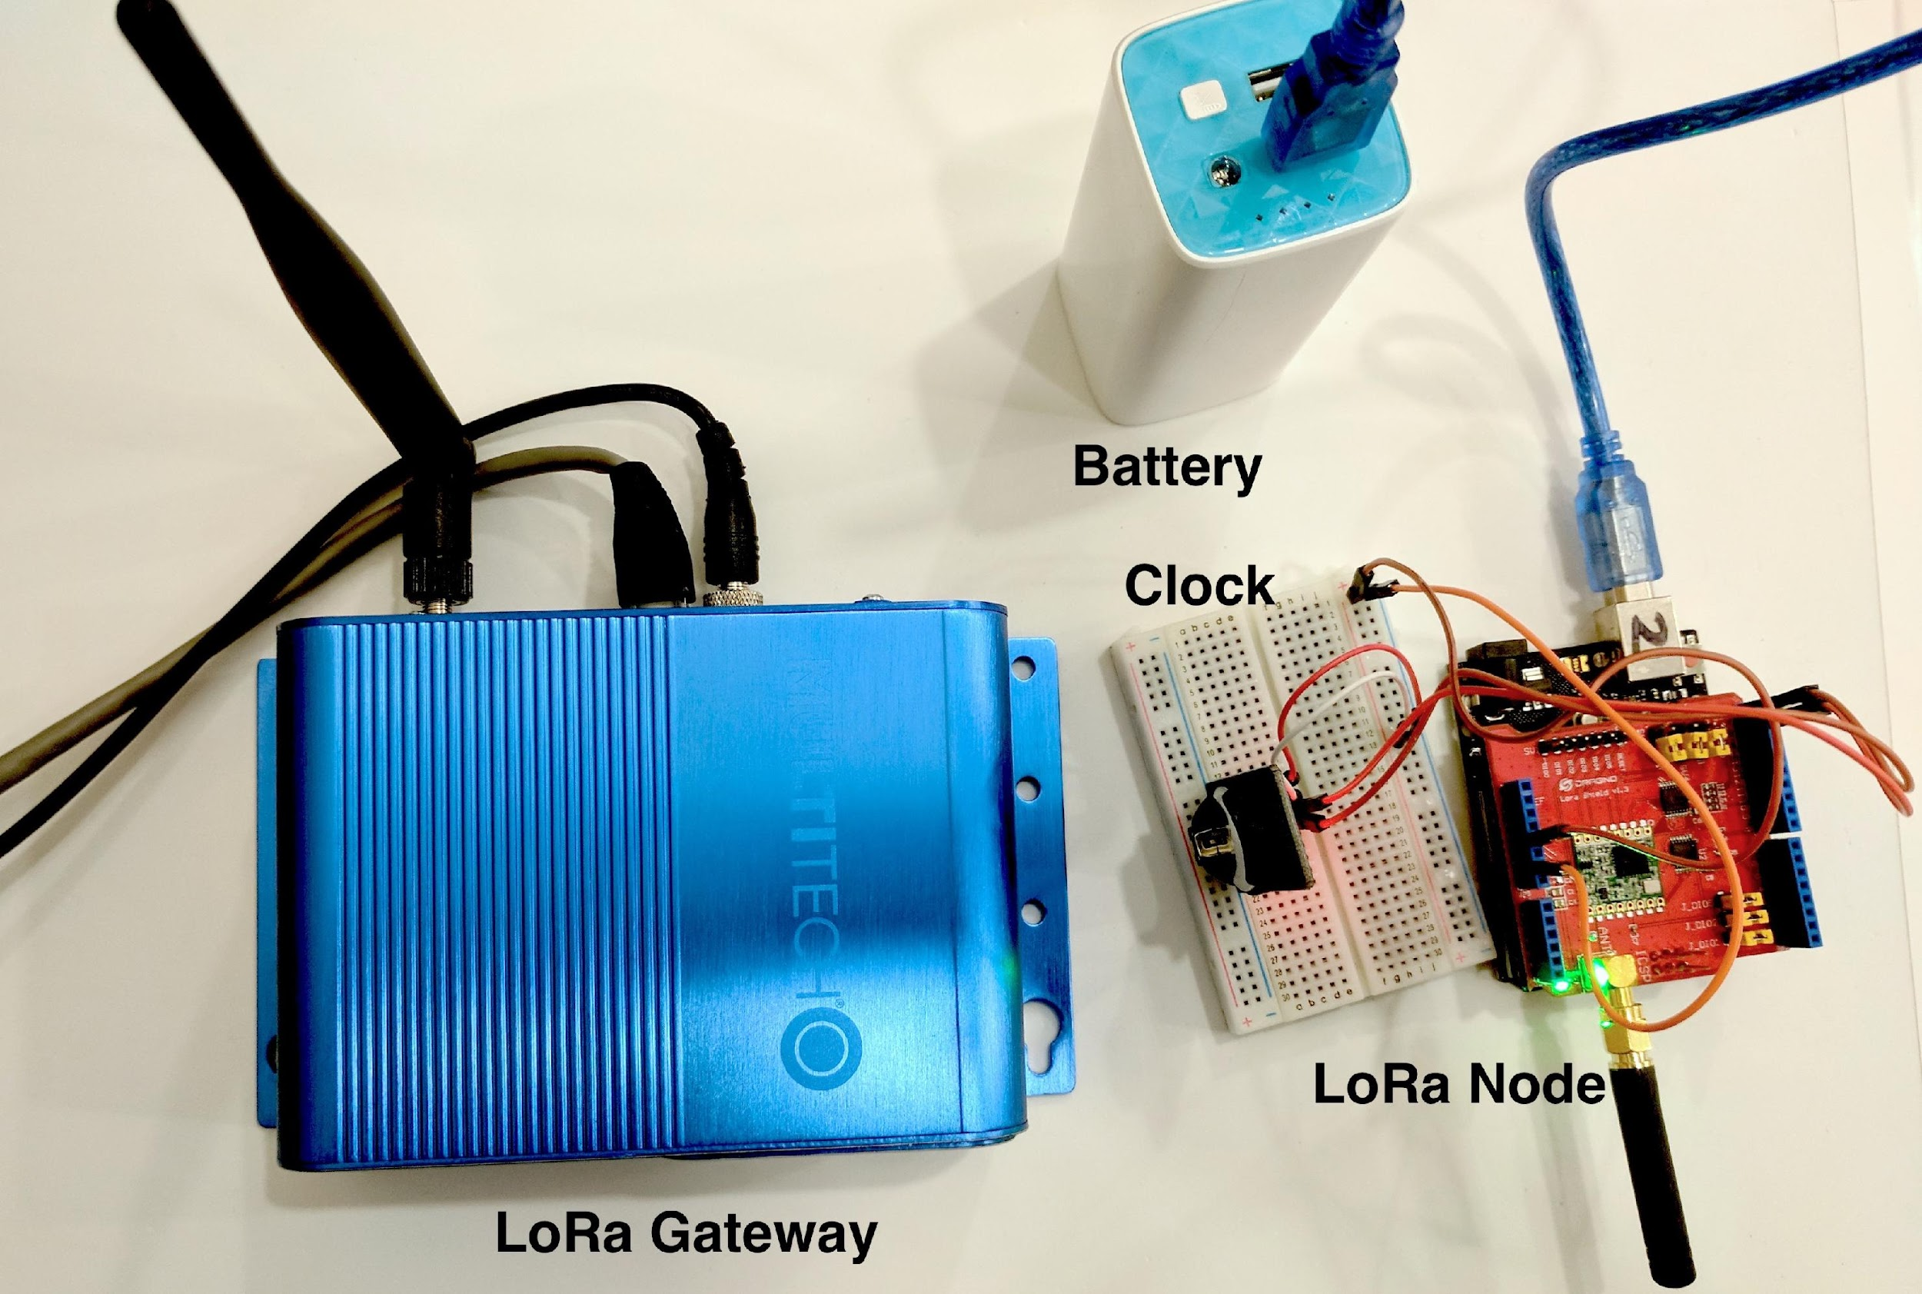
Overview of LoRa
Multi-access Control: Pure Aloha
Notes:
KPN (The Netherlands), which announced the previously mentioned nationwide LoRa network in The Netherlands end June,
Proximus (Belgium), the incumbent operator which was known as Belgacom previously and promises nationwide LoRaWAN coverage in the country by end 2016,
Orange (France), which started with 18 urban areas in the first quarter of 2016 and is expected to offer nationwide coverage soon as well,
Bouygues Telecom (France), also promising nationwide LoRa coverage by end 2016 and offering IoT services with its subsidiary company Objenious.
Unidata, an Italian telecom company, which announced the roll out of a LoRaWan network on June 14th. Initially this will be done in Rome with the promise of a full coverage of the city by 2017.
Netzikon, not a telecom firm but the name of a LoRaWan network which is present already in Stuttgart and will be rolled out nationwide in Germany by 2018 according to an October 4 press release by LPWAN provider Actility.

Slide 51
Outline
Wireless Communication characteristics
Different Wireless Communication technologies
WiFi: 802.11 wireless LANs
Cellular networks: 4G and 5G
Personal Area Network: BLE, Zigbee, …
LPWA: LoRa
Wireless Sensor Network
Mesh WSN
Delay Tolerant Network
VANET

Slide 52
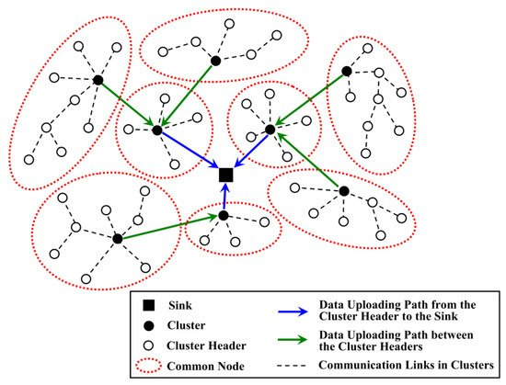
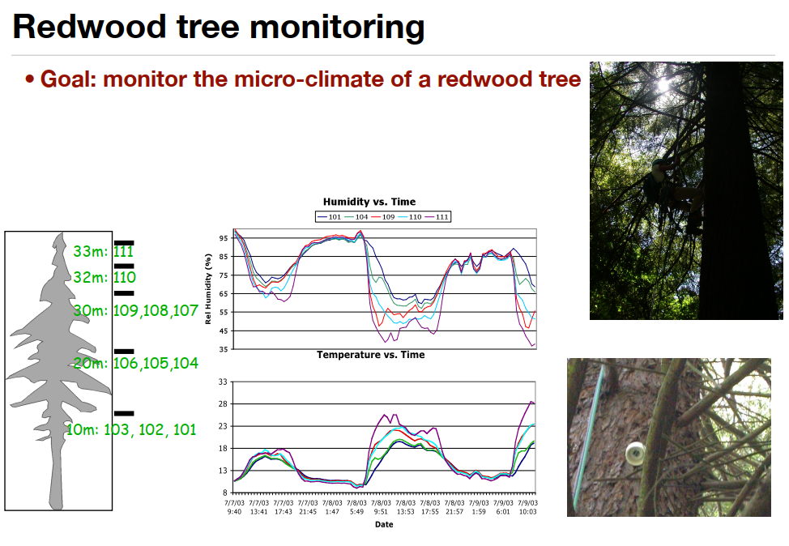
Wireless Sensor Network
Features:
Sensors: battery-supported, sensing and communication (data relay)
No backbone infrastructure or centralized control
Sensitive to Energy Consumption/Latency/reliability
Multi-hop self-organized mesh network:

Slide 53
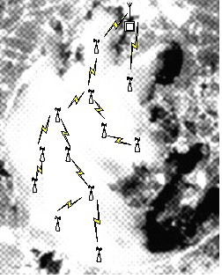

Example 1: Pollution detection in Lake Taihu
Detecting Pollution in Lake Taihu: 3rd largest lake in China
heavily polluted (around year 2010)
deploy sensors to detect pollution
Impossible to communication with cellular network (no stations in the lake)

Slide 54
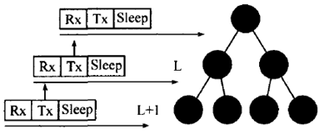
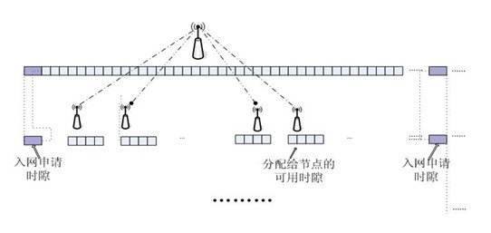
Network Topology
Tree-structure network topology
TDMA-based MAC
Father node accepts the request and assigns time slots for the children nodes

Slide 55
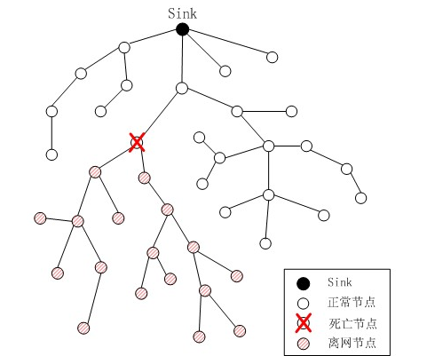

Resistant to failure
Link breakage
Reconfiguration

Slide 56


Example 2: Zebranet
Purpose: track zebras on the field
Solution: GPS + Wireless Communication
ASPLOS'20 - ASPLOS Most Influential Paper Award https://www.youtube.com/watch?v=5c0IhQ07Hfo

Slide 57


Delay Tolerant Network
Store, Carry, and Forward
Usages: disaster response

Slide 58

Basic Research Challenges:
Routing (Flooding) with Intermittent Connectivity

Slide 59

VANET: Vehicular Ad-hoc Networks
Self-driving vehicles, communicate with:
Each other
Pedestrian
Intelligent transport service
…
Know about UMDearborn’s role in VANET:
https://www.youtube.com/watch?v=h9YcwqPn01A

Slide 60

VANET: Vehicular Ad-hoc Networks
For…

Slide 61
VANET: Vehicular Ad-hoc Networks
Dynamic topology with nodes moving at a fast speed
More processing power, storage, and energy than handhelds
Location based information: Accidents ahead
Delay constraints
Varying environments: City streets with tall buildings vs. open high-way roads
Sensors: GPS, Speed, Proximity, engine sensor, etc

Slide 62

VANET: senders and receivers
Vehicle to Infrastructure (V2I)
Vehicle to Vehicle (V2V)
Road-Side Unit (RSU)
On-Board Unit (OBU)
In general, V2X
WAVE: Wireless access for vehicular environments
IEEE 802.11p
IEEE 1609.1-4
SAE 2735

Slide 63
About 802.11P
Design objectives
the longer ranges of operation (up to ~1000 meters)
the high speed of the vehicles (up to ~500 km/h relative velocities)
the extreme multipath environment (many reflections with long delays)
the need for multiple overlapping ad-hoc networks to operate with extremely high QoS
the nature of the automotive applications (e.g. reliable broadcast) to be supported.
Working frequence: 5.9 GHz
802.11p is largely based on 802.11a

Slide 64
802.11bd: evolution of 802.11p for V2X
802.11bd defines MAC/PHY enhancements from 802.11n, ac, ax, to provide a backwards compatible next generation V2X protocol.
Higher Throughput
OFDM frame design
Higher MCS, LDPC coding
Packet aggregation
Longer Range
Mid-amble design
Repeated transmission mechanism
More robust channel coding
Support for Positioning
Backward Compatibility
Backward compatible frame format design, Version indication
Key additions :
Higher throughput (2x) than 802.11p
Longer range (3dB lower sensitivity level)
Support for positioning
Backward compatibility with 11p
To be completed in 2022

Slide 65
Backup Slides

Slide 66

Is WiFi Secure? Short Answer: No
WiFi Connection Establishment
About Wi-Fi Probe:
https://www.youtube.com/watch?v=ixyVdmSdNxs
monitor mode: listen to all signals
https://netbeez.net/blog/station-authentication-association/
Notes:
Okay so let’s move on to the next topic. In one word, is WiFi secure? The short answer is no.
First we will need to understand the WiFi connection establishment procedure. At the beginning of the 802.11 Authentication and Association process, the client scans all of the available frequencies in search of SSIDs to join. The client sends probe request frames which contain supported data rates and 802.11 capabilities. Access points in proximity reply with probe response frames that contain the SSID and BSSID, which corresponds to the access point’s MAC address.
When the client finds an SSID that matches its configuration, it will send an authentication request probe. Important to note is that the authentication request and response probes exchanged in this phase don’t provide encryption. That function is implemented by the 4-way handshake. Here, the authentication request and response exchange is only used to register the client’s MAC address on the WiFi AP. If the client is allowed to connect to the network, it will associate to the access point with the stronger signal.
So just now we mentioned SSID and BSSID. SSID is the WiFi ID for human to read. When you set up your WiFi routers, you need to give it a name that you will see again when you connect to it. The BSSID is for the machine to read. It is the MAC address of your WIFi router.
So here let’s take a look at the probe procedure demonstrated by some youtuber. Please pause this video, and click the link which will redirect you to Youtube. I also want to remind you that some network card provides you with the monitor mode, where you can listen to all signals being transmitted in the air. I worked on indoor localization 8 years ago and we need to capture all transmitted signals. At that time, some network card doesn’t fully support such mode. My experience is that, if your network card is made by Broadcom, it is very likely that you are able to try this function by yourself.
If you are interested to know more about the authentication and association procedure, you can take a look at the link below.

Slide 67


WEP authentication
WEP authentication request
nonce (128 bytes)
nonce encrypted shared key
success if decrypted value equals nonce
WPA Decryption Using Wireshark: https://www.youtube.com/watch?v=G_O_NeNAVuU
8-67
Notes:
Okay now let’s take a look at the encryption procedure, which is called the 4-Way Handshake.
Here we use the the encryption procedure of WEP as an example. The full name of WEB is the Wired Equivalent Privacy protocol. It is the first widely used encryption standard in WiFi and it is the weakest in security level so far. We don’t see it quite often today as it can be cracked easily by some opensource tools.
So first the client will send a WEP authentication request to the AP. Then, the Access Point replies with a clear-text challenge. The third step is, the client encrypts the challenge-text using the configured WEP key and sends it back in another authentication request. Then, the Access Point decrypts the response. If this matches the challenge text, the Access Point sends back a positive reply.
WEP is known to be insecure, as it has some flaws in its encryption procedure. Now we use WPA and WPA2 instead in most home networks when you setup your WiFi routers. I’d recommend you to check your WiFi settings, and switch to WPA2 if you are currently using WEP or WPA. Do some search you will find a lot of tools that can crack WEP or WPA. The underlying reasons are not the same. WEP has some design flaws while a network using WPA or WPA2 can only be cracked if you set some simply password turn on the wrong security settings. So if you follows the rules, do the correct security setup, and pick a complicated password for your home WiFi router, you should be safe.
The reason we still claim the WiFi to be insecure is, many of us are using the public WiFi networks. When you go to a coffee shop, a hotel, or a local restaurant, you may connect your phones to the WiFi provided by them. Without proper security settings, these networks can be extremely insecure. Please watch the video listed here, and it shows you how a hacker can find out your raw messages, when he lives in the same hotel as you and gets the password to connect to the WiFi just like you.

Slide 68
Then, what should we do?
If we want to use WiFi in public?
Don’t attack others!
Use VPN: Virtual Private Networks
VPN provides Network Layer Confidentiality:
WiFi Encryption: link layer
TSL: transport layer (port to port, some servers)
Network Layer: all data sent from one entity to another would be hidden!!!
Notes:
The video is pretty astonishing, right? Basically it means that without proper security mechanisms, your messages exchanged with the access points can be captured by other clients physically close to you. It can be someone sitting next to you in a restaurant, but you will never find out as the hacker no longer need to plug a cable to the hub you are using. So what should we do to protect ourselves?
The first thing is you don’t want to attack others. Then, in public networks, use VPN. The WiFi encryption can be considered as encryption for the link layer, while TSL and SSL that we introduced in the last course is the security mechanism for the transport layer, for port to port communications. SSL requires the server to implement the services, and is application specific. What if I want to make sure all my traffic are encrypted? Such security should be provided by the network layer, which means that all data sent from one entity, which is your machine, is hidden.
So VPN, the virtual private network is the right way of doing this.

Slide 69

Some Background about VPN
institutions often want private networks for security.
costly: separate routers, links, DNS infrastructure.
VPN: institution’s inter-office traffic is sent over public Internet instead
encrypted before entering public Internet
logically separate from other traffic
Use IPsec to protects upper level protocols.
Notes:
Here is some background of VPN. Now many of us are working from home, and we are using public network infrastructures. Before, when we are at work, all data goes through the network of our companies, right? So if there are any data leakage, that’s not our fault. Now all our data goes through the public network. What if, let’s say, some one in comcast wants to capture some sensitive information sent by us? I know it is very unlikely to happen, but just assume that you company wants to purchase another company and you are working on that. Although you are very carefully about the security, and you use SSL and other security mechanism to send emails and exchange information with other, you may still Google the name of that company and search for public information about that company. If someone can capture your traffic, what will cause information leakage.
It is not possible that your company can build a dedicated private network for you to enhance security, because it is costly, and also because I think the pandemic will soon be gone as we already have the vaccine. So what they do instead is to require you to install a VPN. All outgoing traffics are encrypted before it enters public internet so that all the routers on the path cannot find out what you are transmitting. VPN are built upon IPSec. Basically VPN builds an encrypted tunnel from the client to the VPN server. Now you can re-route all your encrypted traffics to your company and your company will handle the security for you.
So we will take a break here. In this part, we learnt about the common wireless local area network standards including WiFi, Bluetooth, Zigbee, right? And we talked about the multi-access protocol used in WiFI, the CSMA/CA. We talked about the connection establishment procedure of WiFi and the encryption. We know WiFi is not secure so we can use VPN if we use public WIFi networks.

Slide 70


Components of cellular network architecture
MSC
connects cells to wired tel. net.
manages call setup (more later!)
handles mobility (more later!)
cell
covers geographical region
base station (BS) analogous to 802.11 AP
mobile users attach to network through BS
air-interface: physical and link layer protocol between mobile and BS
Mobile
Switching
Center
Public
network
Mobile
Switching
Center
wired network
Notes:
So first we need to know the cellular network architecture. Theoretically, each cell tower covers a hexagon /hek·suh·gaan/ region. These cell towers connect we the users to mobile switching centers. The switching centers are then connected to either the phone network or the Internet.

Slide 71

Routing Under Mobility
Problem Demonstration:
1) A passenger in a car sends an HTTP request;
2) Move out of the range of the original AP when the response comes back
Two types of handoffs:
Micro handoff
Macro handoff
Notes:
Next let’s think about mobility. Consider that a passenger in a car sends an HTTP request. Then, he or she moves out of the range of the original AP when the response comes back. How does the cellular network help the user to get the response?
The short answer is the handoff management strategy. Handoff management is the process by which a mobile node keeps its connection active when it moves from one access point to another. In general, there are two types of handoff problems. First is the micro handoff, or say the local handoff. Our example belongs to this category. The second is the macro handoff, or say wide area handoff. You can think of it as you hold a Verizon cell phone but travel in Japan now. I guess there is no Verizon network in Japan, so the local cellular network providers don’t know who you are, but still need to route the packet to you.

Slide 72


Micro Handoff
hard handoff: connect after break
Soft handoff: connect before break
hard handoff
Soft handoff
Notes:
So first let’s consider the micro handoff. There are two types of micro handoff. The first is hard handoff, which means connect after break. When a mobile node moves from the coverage region of one cell tower to another cell tower, it first break the connection with the original cell tower and then connect to the new cell tower. In 2G and some 3G networks, we can only use the hard handoffs.
And then, the researchers and engineers developed soft handoff. Soft handoff means to establish connection to the new cell tower before breaking the connection to the former cell tower. It is possible today as the coverage regions of cell towers have more overlaps. Besides, our wireless network chips are optimized for this, so that it can connect to two cell towers simultaneously.

Slide 73



Macro handoff: Mobile IP
Consider friend frequently changing addresses, how do you find her?
I wonder where Alice moved to?
search all phone books?
call her parents?
expect her to let you know where he/she is?
Facebook!
Home network:
permanent address
Foreign network:
Temporary address
Notes:
Then let’s consider the macro handoff. Macro handoff is kind of like Facebook to us. You must have friends that frequently changes their addresses or locations. How do you find him or her? Thanks to the big tech companies, now we have mobile phones, facebook, and linkedin, right? You can always find out where he or she is via these contact information that won’t change. Then, if you want to send him or her some packages, you can ask for the address, and have the package delivered to the updated address. Many Macro handoff strategies are built upon the basic concept of Mobile IP.
This is the basic idea behind mobile IP. In mobile network, if you want to find someone’s temporary address, you need to have some anchor to locate that person. Here the anchor is the home network address, or say the permanent address of the mobile device. You can understand it as, I am using the ISP of Verizon, so my home network is Verizon, or more precisely, a database table maintained by Verizon about where to find me. Then there are foreign networks. Foreign networks are like the cell towers you connect to. They only have the temporary address of you. Such temporary addresses are also called care of addresses.

Slide 74


Mobility: registration
visited network
home network
1
2
wide area network
mobile contacts foreign agent on entering visited network
foreign agent contacts home agent “this mobile is resident in my network”
end result:
foreign agent knows about mobile
home agent knows location of mobile
Notes:
When a mobile node visits a foreign network, it needs to contact the foreign agent to first complete the registration procedure, so that the foreign agent knows about the mobile node and the home agent knows its current location.
You can think of the registration as, the Japan’s ISP contacts Verizon, saying that I find this cell phone in my service region, and he claims to know you. Do you know him? And then Verizon updates such information in the database, and tell the ISP in Japan to continue the mobile data service.

Slide 75

Mobility via indirect routing
Notes:
There are two ways of routing the data back to the mobile node in a foreign network. The first is indirect routing. In such routing, when you travel in Japan, you will still use your permanent IP address assigned to you by your home network. When someone needs to send you a packet, it will be sent to your home network first, and then the home network will replace the designation IP address of that packet from your permanent IP to your current IP address in the foreign network, which is called care of address, and send that re-route that packet to your foreign network.

Slide 76



Mobility with direct routing
anchor foreign agent: FA in first visited network
data always routed first to anchor FA
when mobile moves: new FA arranges to have data forwarded from old FA (chaining)
foreign net visited
at session start
anchor
foreign
agent
wide area network
2
1
4
5
3
new
foreign
network
correspondent
agent
new foreign
agent
correspondent
Notes:
The other is direct routing. Instead of always using the permanent address of the home network, the mobile node now uses the temporary address. Upon receiving a packet, the foreign network handles how to send that message to the node.

